Slide 1
Endava Social Analyzer
Presented by Tarapana

Slide 2
Agenda
Introduction of the team and product
About product
Main features
Benefits of using our product
Live demo
Technology stack
Q&A

Slide 3
Introduction
Tarapana team members:
Slavko Komarica
Marko Kaplarevic
Milos Mutavdzic
Dejan Kojic
Damir Alibegovic

Slide 4
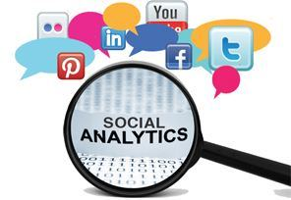
Introduction
What is social analytics?
Collection and analysis of statistical, digital data on how users interface with an organization
Primary form of business intelligence, used to identify, predict, and respond to consumer behavior

Slide 5

About product
What is Endava Social Analytics?
Do your have your overall marketing and business strategy centralized?
Have you defined marketing and business goals that can be tied to actions and events on just one place?
How can you prove the value and impact of your social media activity?
Do you have Endava Social Analytics?

Slide 6
Main features
Support for Facebook, Tweeter and LinkedIn
Different types of analytical reports
Configurable analytical reports
One channel to rule them all

Slide 7
Benefits
The reasons behind developing the solution
Who will benefit from it
Performance/productivity improvements
Financial benefits

Slide 8
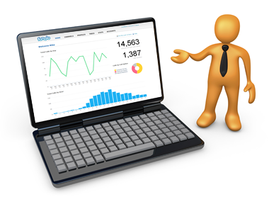
Live Demo

Slide 9
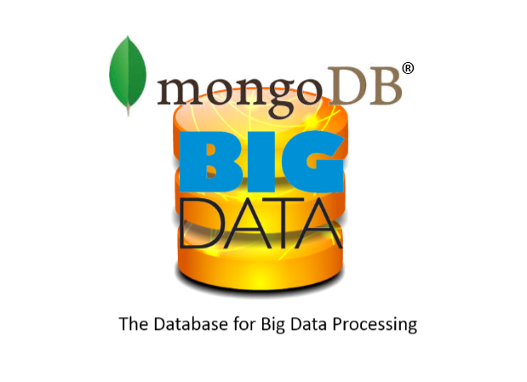
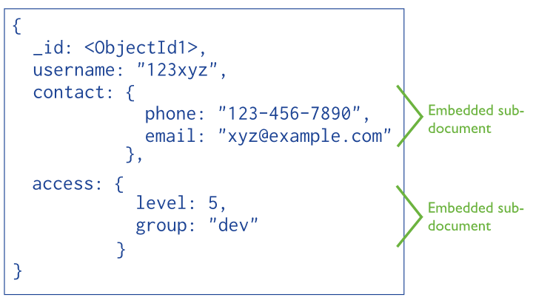
Technology stack
MongoDB
High insert rate over transaction safety
Database scaling
Data is location based
Load and performance advantage

Slide 10








Technology stack

Slide 11
Thank you for your attention!

